Slide 1

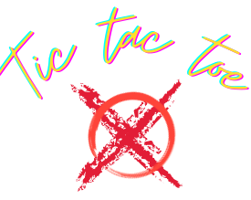
Multiplayer Tic-Tac-Toe Game Using Socket Programming
SRM INSTITUTE OF SCIENCE AND TECHNOLOGY
DEPARTMENT OF COMPUTATIONAL INTELLIGENCE
Assigned by :Dr. A. Revathi - Assistant Prof
Team:
Rahul Kumar Agrahari (Lead)(RA1911033010053)
Mohd Zaid (RA1911033010062)
Anirudh Saxena (RA1911033010069)

Slide 2
Table of Contents
Abstract
Introduction
What is Socket Programming?
Methodology
Scope of the project
Screenshots

Slide 3
Abstract
The programming Language that I use for the project is python version 3.7
The game is basically multiplayer ,so over here the role of socket programming comes into picture
The two players are connected to each other with the help of socket and assigned ports in order to make the communication possible
For the interface I have used pygame and tkinter these are python GUI toolkit
The user will provide their name and choices in order to play the game
Once they provided the conventional input that are required there game begins
Now the sockets will be connected
Communication will take place
In the end the results will be declared as per the Algorithm used
The results are Win ,Lose or Draw

Slide 4
What is Socket?
Sockets and the socket API are used to send messages across a network. They provide a form of inter-process communication (IPC). The network can be a logical, local network to the computer, or one that’s physically connected to an external network, with its own connections to other networks. The obvious example is the Internet, which you connect to via your ISP.
Sockets have a long history. Their use originated with ARPANET in 1971 and later became an API in the Berkeley Software Distribution (BSD) operating system released in 1983 called Berkeley sockets.
Why should you use TCP? The Transmission Control Protocol (TCP):
Is reliable: packets dropped in the network are detected and retransmitted by the sender.
Has in-order data delivery: data is read by your application in the order it was written by the sender.

Slide 5
Methodology
First of all we run the respective Tkinter GUI file
Then we will fill the required details needed to begin with the game
Then the respective pygame window for both the player will be displayed
The players are required to choose the block they want to select
In the end The result will be displayed on the players respective Window

Slide 6
Scope of the project
The scope of the project is multifold.
If we can introduce a AI bot as one of the player.
Then we can set the difficulty level of the game as per the deployed AI Bot respectively

Slide 7
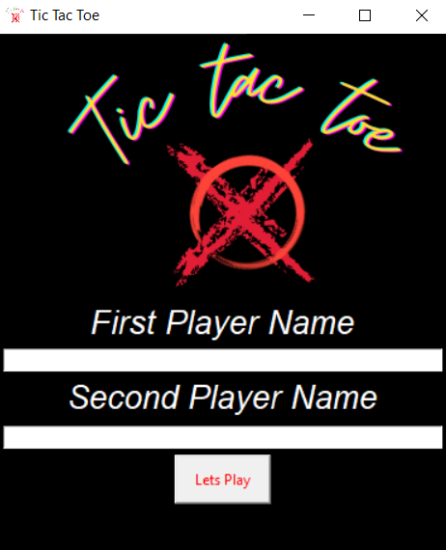
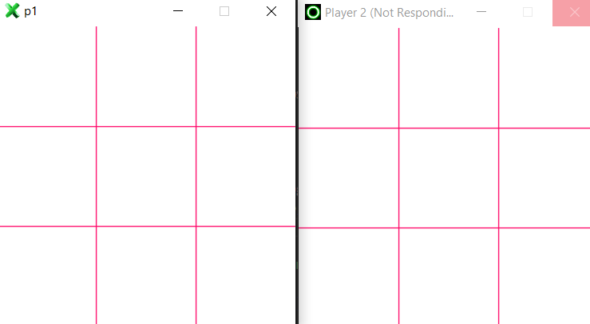
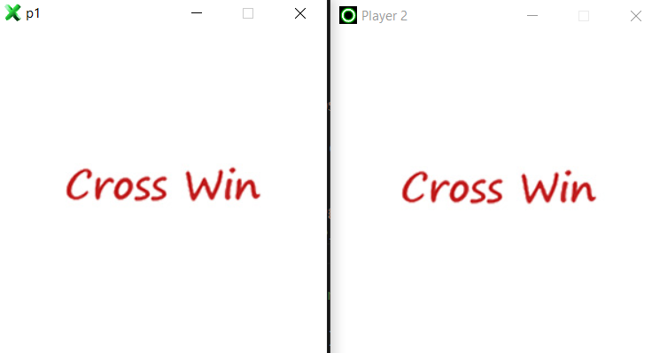
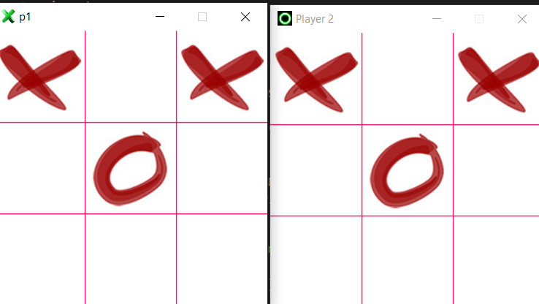
ScreenShot

